Slide 1
National Identity Card (NID)
-Bhumika Maharjan

Slide 2
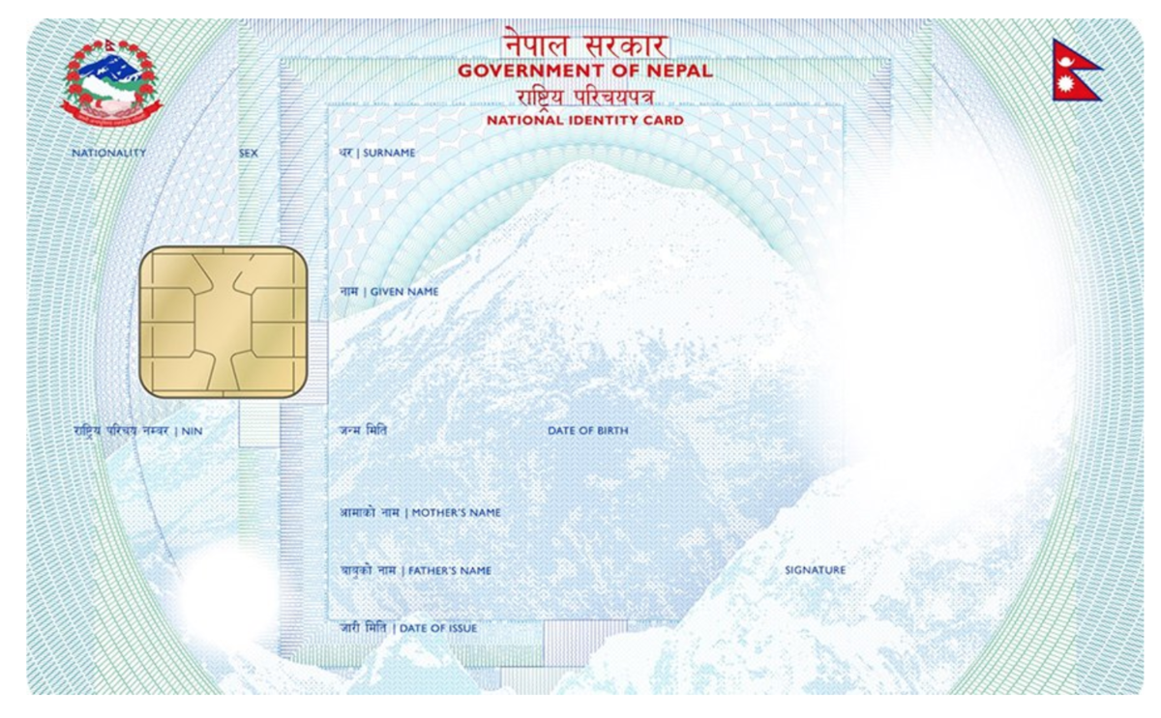
Introduction
The NID is a government-issued identification card based on smart card technology with an electronic chip, containing the demographic and biometric details of citizens, along with security features.
It is used for various purposes, including accessing government services, voting, and verifying identity.

Slide 3
Mission, Vision & Goals
Mission
Vision
Goals
To provide a secure and reliable identification system for all citizens of Nepal.
Ensure every citizen has a unique identity number.
Integrate NID with various government services.
Prevent identity theft and fraud.
Promote inclusivity for all citizens.
Enhance the efficiency and transparency of government services.

Slide 4
Objectives
Register citizens and maintain a secure national database.
Integrate NID with service platforms to improve public service delivery.
Modernize civil registration systems.

Slide 5
E-Governance Model and Interaction
E-Governance Model:
Interactive-Service Model: Citizens access NID services online like NID registration, updates, and verification online.
Form of Interaction:
G2C (Government to Citizen): Citizens use NID for services like passports, banking, voting etc. .
G2G (Government to Government): Facilitates data sharing between government departments for coordinated governance and service delivery.

Slide 6
Technology Used by NID
Biometric Data Capture: Utilizes fingerprint scanning, facial recognition, and iris scanning to ensure unique identification.
Smart Card Technology: Incorporates embedded chips to store personal and biometric data securely.
Centralized Database System: Maintains citizen information in a secure, centralized repository for efficient access and management.
Online Service Portals: Facilitates identity management and verification through secure online platforms.

Slide 7
SWOT Analysis
Strengths:
Unified Identification System
Enhanced Security Features
Easier Access to Services
Opportunities:
Expansion of Digital Services
Streamlined Public Services
Increased Citizen Engagement
Weaknesses:
High Implementation Costs
Limited Digital Literacy
Technological Challenges
Threats:
Cybersecurity Risks
Resistance to Change
Data Misuse Risks

Slide 8
GAP Analysis
Current State:
Ongoing enrollment of citizens into the NID system.
Partial integration with service delivery platforms.
Desired Future State:
Complete nationwide coverage with all citizens enrolled.
Full integration with both government and private sector services.
Identified Gaps:
Incomplete enrollment due to geographical and infrastructural challenges.
Limited awareness and acceptance among the populace.

Slide 9
Suggestions
Increase public awareness and digital literacy programs.
Enhance cybersecurity measures to protect citizen data.
Improve infrastructure to support the NID system.
Partner with private tech companies to improve system integration

Slide 10
Thank you

